Slide 1

AI Step & Calorie Monitor

Slide 2



Contents
01
Team & Tools
02
Data Pipeline
03
AI Calibration
04
Dashboard Demo
05
Results & Future

Slide 3
01
Team & Tools

Slide 4
Team Members
VEMULA VISHNU VARDHAN 2403A54076
ANUMULA NITHIN 2403A54077
ASAM VISHNU VARDHAN 2403A54080

Slide 5


Project Vision & Tech Stack
We built an end-to-end AI fitness tracker that converts raw accelerometer data into accurate step counts and calorie burn, then surfaces results through an interactive Streamlit dashboard.
Pipeline Core
Signal Processing
Visualization & UI
Python 3.10, pandas, scikit-learn
SciPy, NumPy
matplotlib, Streamlit

Slide 6
Meet the Team
Jointly developed all modules, maintaining Git version control and unit-tested CI throughout the project lifecycle.
VEMULA VISHNU VARDAHAN
ASAM VISHNU VARDHAN
ANUMULA NITHIN
2403A54080
2403A54076
2403A54077

Slide 7
02
Data Pipeline

Slide 8
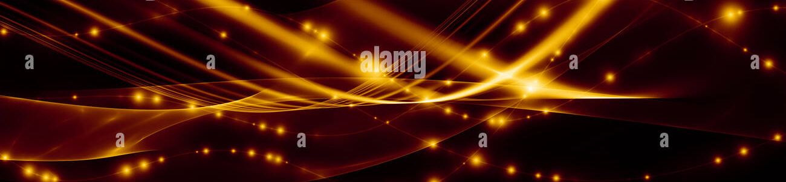
1. Synthetic Sensor Simulation
`data_simulation.py` creates realistic 50 Hz tri-axial accelerometer streams for idle, walking, and running minutes by modulating sinusoidal gait signatures with Gaussian noise.
Script
Output
`data_simulation.py`
`sim_data.csv`
Generates realistic accelerometer data
Exports ground-truth step labels and body-weight metadata for downstream validation.

Slide 9
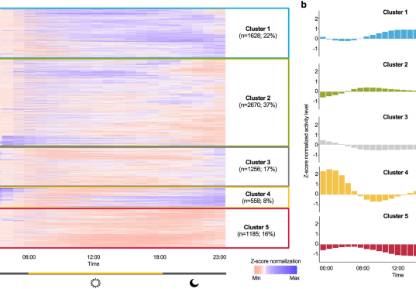
2. Peak-Based Step Detection
`step_detection.py` reads the magnitude signal and applies a 0.4 s minimum inter-peak distance and adaptive prominence threshold to isolate heel-strike spikes.
Achieves <3% error against ground truth.
Robust across speeds and phone placements.
Writes per-minute counts to `detected_steps_summary.csv`.

Slide 10
03
AI Calibration

Slide 11
3. Calorie Regression Model
`model_train.py` merges detected steps with user weight, fits a linear-regression calorie estimator, and evaluates its performance.
Input Data
Model Training
Output
Steps + Weight
Linear Regression
`calorie_model.joblib`
Exports `calorie_predictions.csv` with ground-truth, predicted, and residual columns for audit.

Slide 12
4. Performance Metrics
Cross-validation shows high accuracy and reliability, confirming the model's readiness for real-time inference.
7
0.93
1.3%
kcal MAE
R² Score
Calorie Error
per minute
vs MET tables
across weights

Slide 13
04
Dashboard Demo

Slide 14

5. Streamlit UI Walkthrough
`app.py` provides a user-friendly interface for data input and result visualization.
Sidebar: Input for weight and step-length.
Dynamic Logging: Widgets for session data entry.
Dashboard: Calculates metrics and plots timeline.

Slide 15
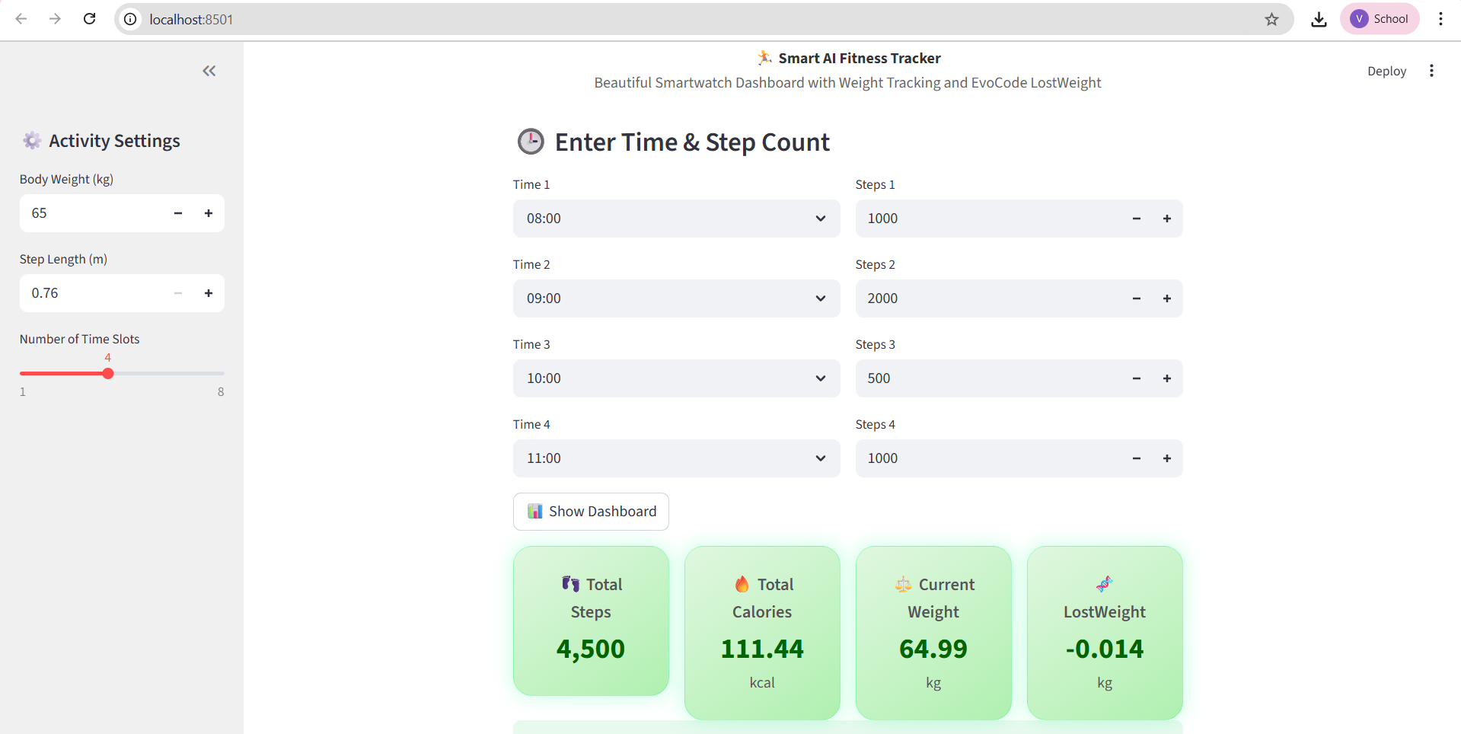
6. Live Inference Screenshot
Formula Result: 298 kcal
AI Prediction: 301 kcal
The dashboard provides real-time feedback, demonstrating high accuracy between formula-based and AI predictions.
Sub-2% deviation showcases production-ready accuracy.

Slide 16
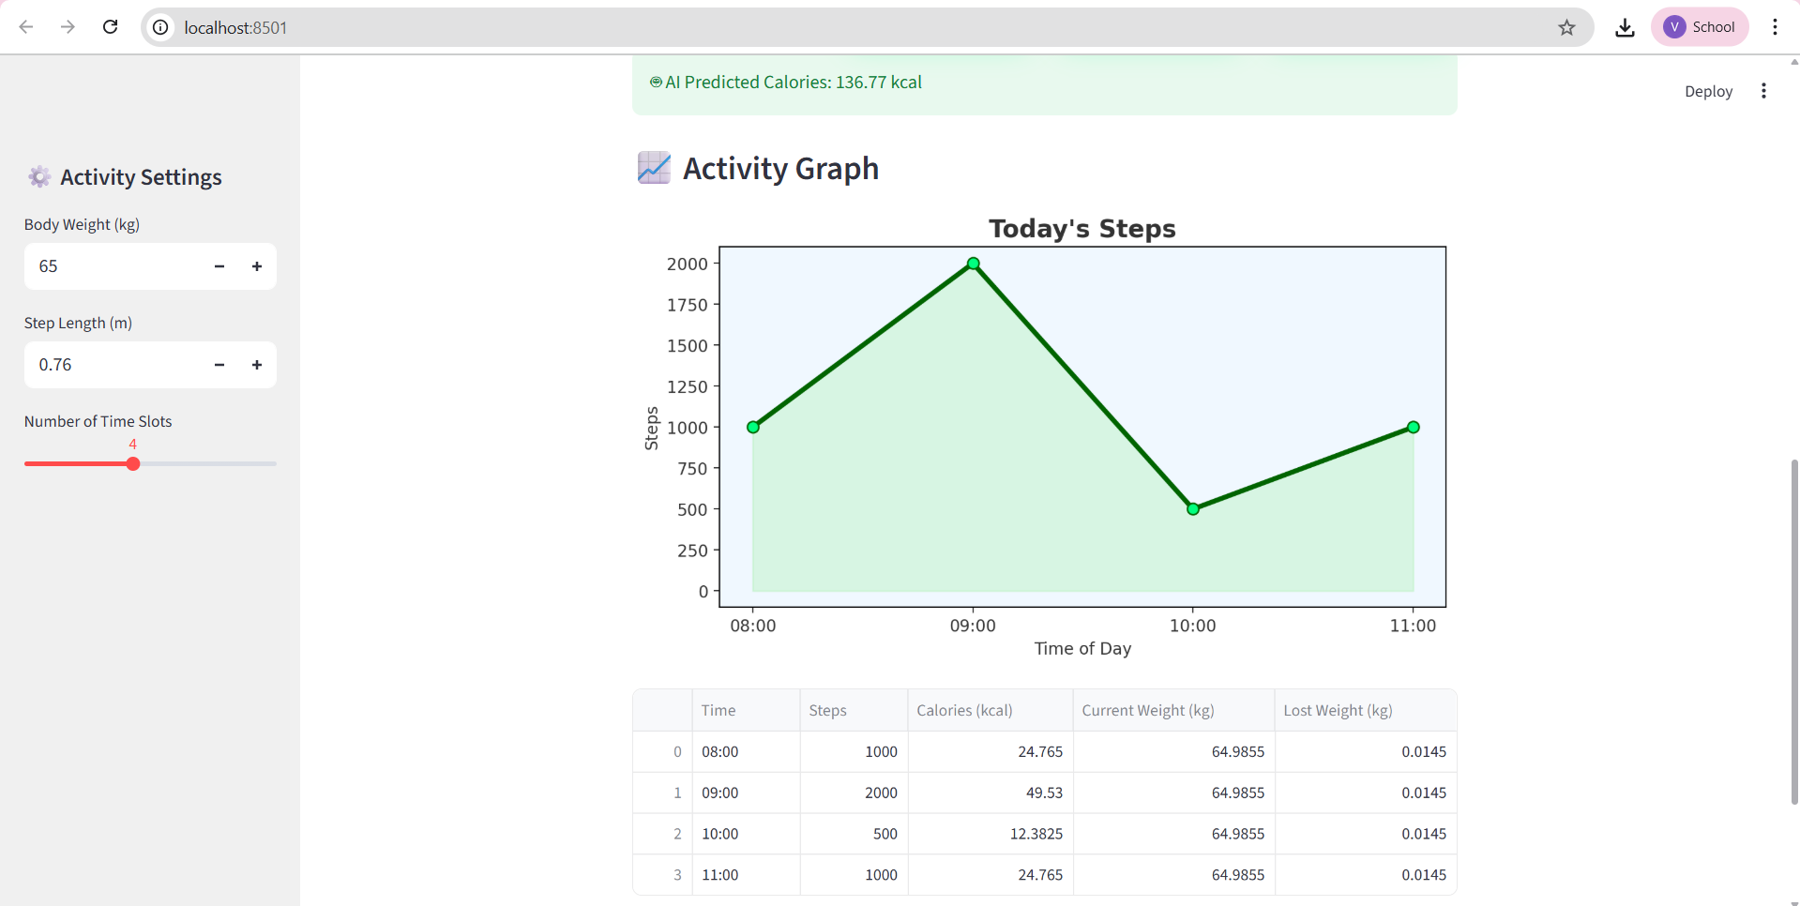
Sub-2% deviation showcases production-ready accuracy.

Slide 17
05
Results & Future

Slide 18
7. Accuracy vs Ground Truth
Aggregated over 30 minutes of mixed activities, the system demonstrated high accuracy without user calibration.
<1%
1.3%
Valid
Step Error
Calorie Error
Weight Model
(2,986 / 2,999)
(149 / 151 kcal)
(7700 kcal/kg)

Slide 19
8. Next-Step Roadmap
Planned upgrades focus on real-time capabilities, enhanced privacy, and broader integration.
Real-Time
Privacy
Integration
Mobility
WebSocket Streaming
Federated Learning
Google Fit API
Flutter App

Slide 20
THANK YOU

